Slide 1
Fake News Detection
Carson Hanel Mohammed Habibullah

Slide 2
Explanation of our program
During the last year, one of the issues that has plagued the global political spectrum has been the prevalence of unsubstantiated news reporting. Though there has been a wide push for journalistic integrity and rigor to intensify, still we’ve seen that unsubstantiated or misleading news has made its way into social circles including online media locations, such as Twitter and Facebook. This project is our naive approach to understanding patterns in news which would be indicative of a false article, which builds upon features extracted from the corpus to essentially draw a line in the sand between news articles that have been deemed substantiated. We hope that you like what we’ve done, but we would like to remind you all that this is a closed environment test, and as such is biased due to some data being orthogonal between real vs. fake datasets.

Slide 3
Program flow
Scraping and cleaning of data
Feature engineering
Maximum entropy model learning of body textual content
Maximum entropy model learning of head textual content
Maximum entropy Frankenstein model (original)
Feature extraction
Psuedo maximum entropic classifiers run through neural network
Gradient Boost scoring of final extracted features across all documents
Evaluation of real vs. fake accuracy
Data insight gathering

Slide 4
Scraping the data and data cleaning
Extracted the Fake News data from Kaggle and the real news data from TheGuardian API.
Dropped the irrelevant News sections and retained news articles on US news, Business, Politics & World News and converted it to .csv format.
Data preprocessing: 1. dropped irrelevant columns such as urls, likes and shares info etc. 2. removed stop words and high bias word like guardian and the guardian etc. 3. Performed lemmatization to bring the word to their basic form
Merged the Fake News and Real News into a csv with an additional Fakeness column.

Slide 5
Feature Engineering
Jaccard Similarity: It calculates the overlap between the headline and body of the news article.
Sentiment Feature: It calculates the polarity scores of headline and body using Vader(Valence Aware Dictionary and Sentiment Reasoner) sentiment analyzer.
Named Entity similarity feature: It calculates the cosine similarity between the counts of the named entities from the Headline and Body.
Polarity feature: It indicates the polarity of headline and body towards refuting words like ‘fraud’, ‘hoax’, ‘debunks’, ‘denies’.
Miscellaneous features: it’s the counts of various chargrams and n-grams that are occurring in the headline and body.

Slide 6
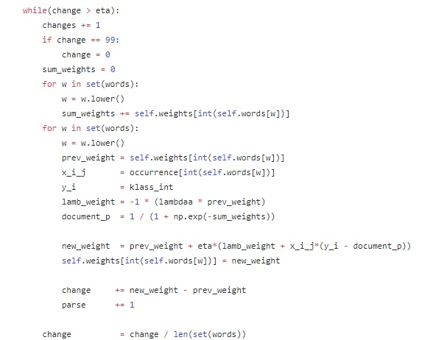
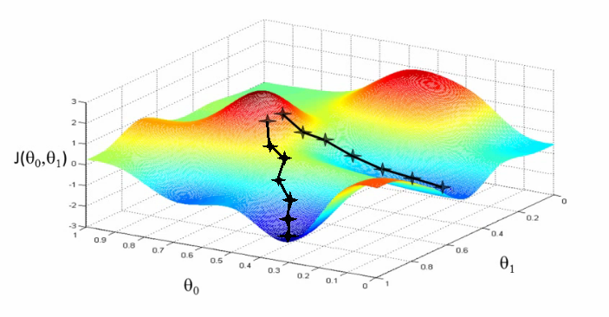
Maximum Entropy Classifier

Slide 7
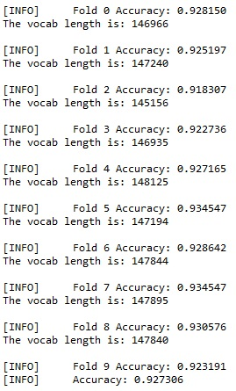
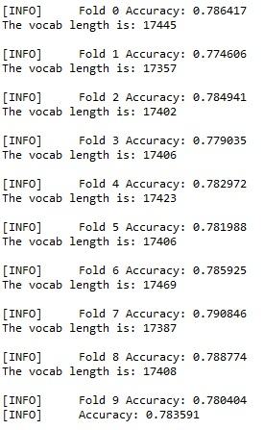
Maximum Entropy Results
To the left you’ll see body content
To the right, you’ll see headline content

Slide 8
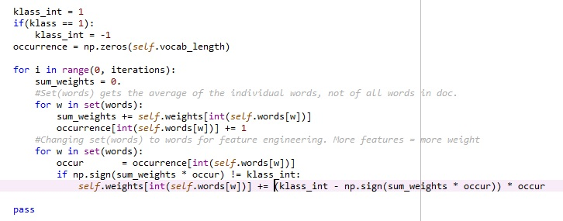
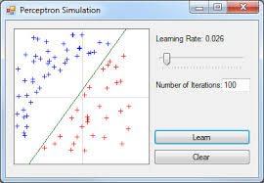
Perceptron Classifier

Slide 9
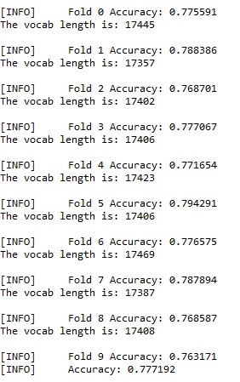
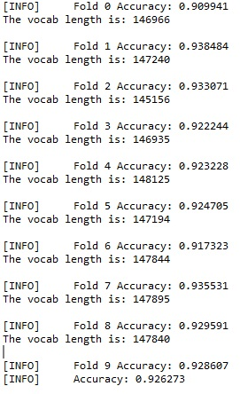
Perceptron Results
To the left, you’ll see the body content To the right, you’ll see the headline content

Slide 10
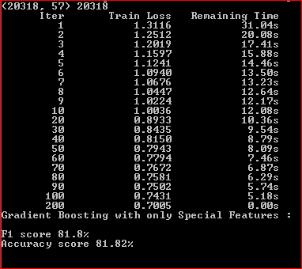
Baselines and Improvements
Baseline is running Gradient Boosting Classifiers with just the features extracted in Feature Engineering. The Baseline has F1 Score= 81.8% and Accuracy= 81.82%. We found

Slide 11
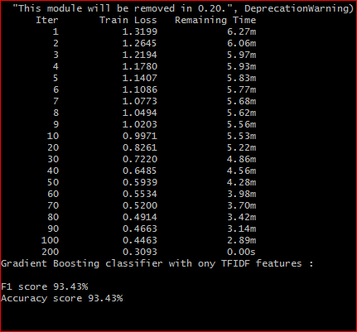
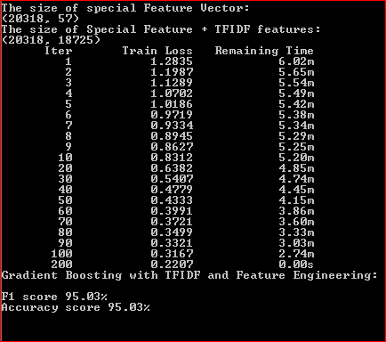
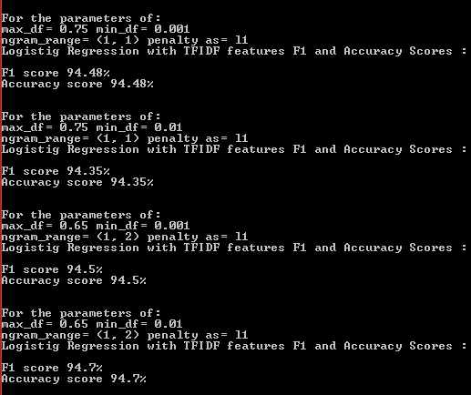
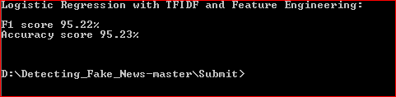
Few More Approaches with TF-IDF Features:
We then tried with TF-IDF as Feature Vectors for logistic regression classifier and Gradient Boosting Classifier. And then combined them with extracted features from Feature Engineering. Below are the results for the same
Logistic Regression with TFIDF + extracted Features
GB With only TF-IDF
GB With TF-IDF + extracted Features
Logistic Regression with only TF-IDF

Slide 12
Neural Network design
Runtime for total neural network to train:
Approximately 2 to 2.5 hours
Headline Data
Body Data
Headline & Body Data
Maxent Model
Maxent Model
Feature Extraction
Gradient Boost
Classification

Slide 13
Gradient Boosting Classifier
It is a classifier which produces a prediction model in the form of an ensemble of weak prediction models in a forward stage-wise fashion.
At each stage 1. It computes the residual error (loss function e.g Mean Square error) 2. Learn to predict the residual 3. Combines (adds) the new model with the predecessor weak model The classifier can be tuned by parameters like n_estimators : The number of boosting stages to perform. loss : loss function to be optimized. learning_rate : There is a trade-off between learning_rate and n_estimators.

Slide 14
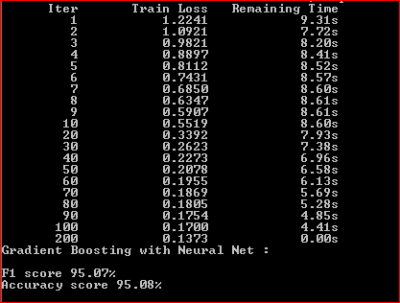
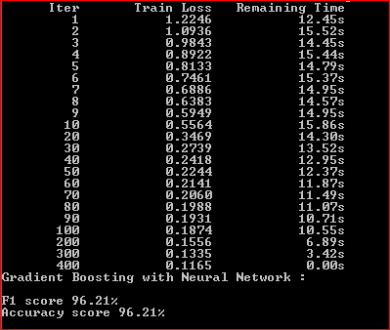
Gradient Boosting Classifier results
With One Fold
For Complete Dataset

Slide 15
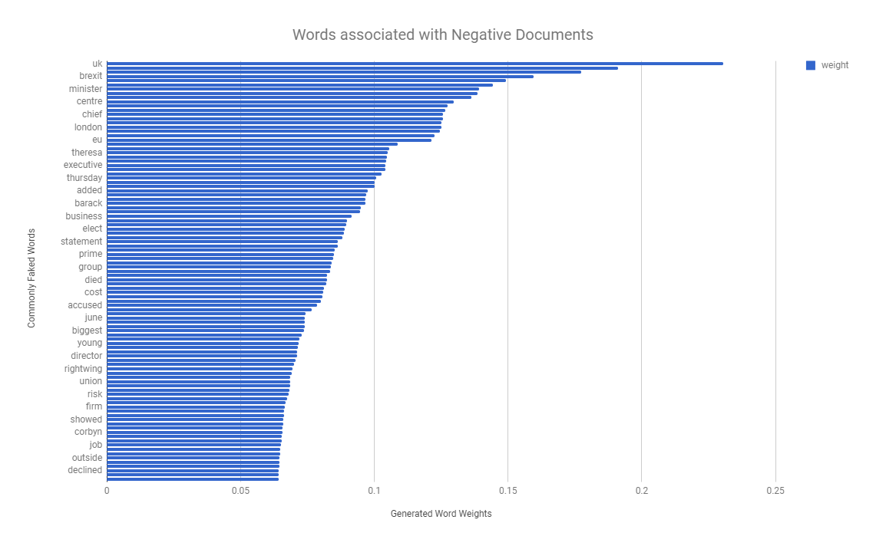
Real News Weights for Body

Slide 16
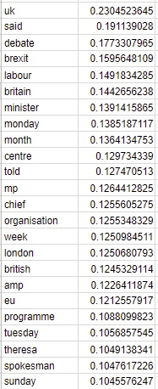
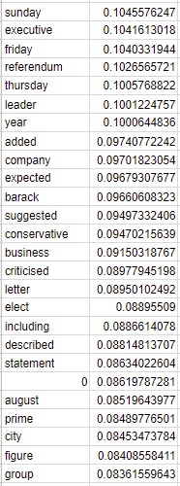
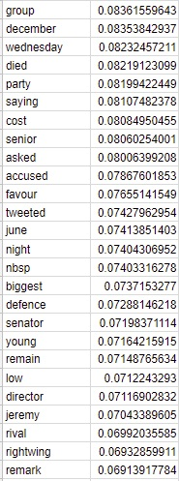
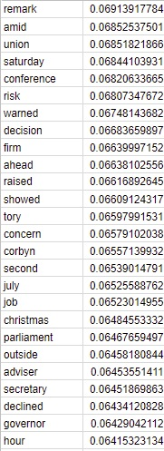
Real News Weights Overview

Slide 17
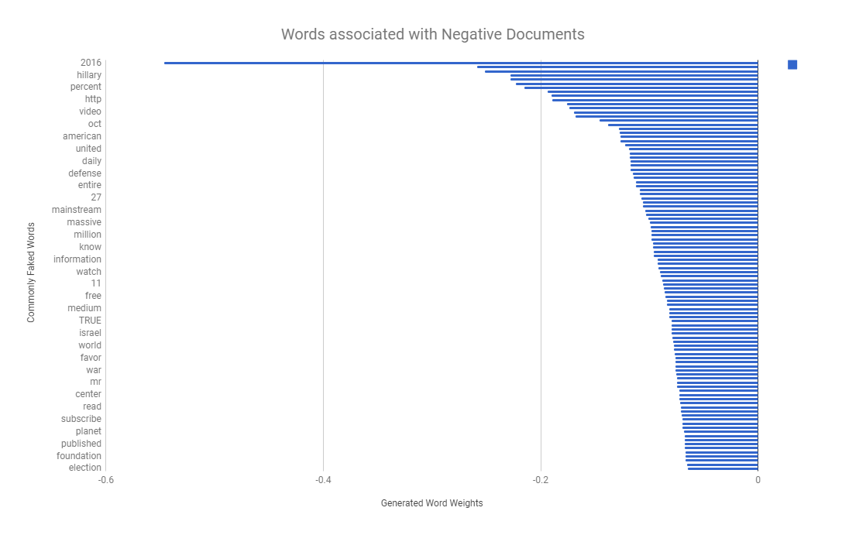
Fake News Weights for Body

Slide 18
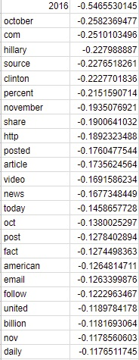
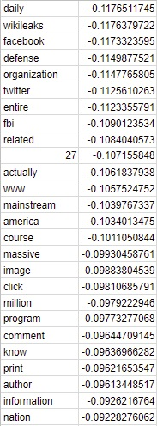
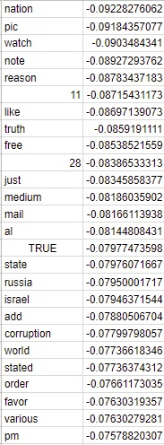
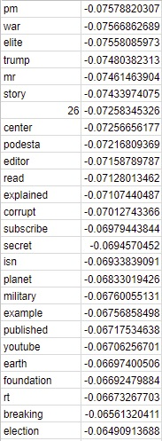
Fake News Weights Overview

Slide 19
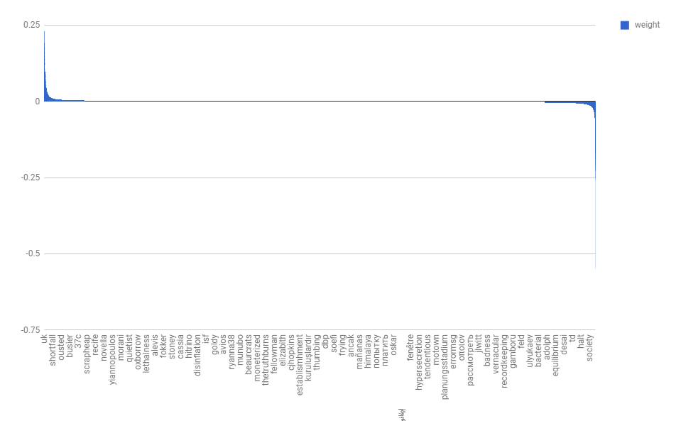
Entire Corpus Weights

Slide 20
Resources
Vader Feature: http://comp.social.gatech.edu/papers/icwsm14.vader.hutto.pdf http://www.nltk.org/api/nltk.sentiment.html
Jaccard Similarity: http://www.iaeng.org/publication/IMECS2013/IMECS2013_pp380-384.pdf https://pdfs.semanticscholar.org/1554/884e643d811c0a3933ea22d6995afc63e912.pdf
Gradient Boosting Classifier: http://blog.kaggle.com/2017/01/23/a-kaggle-master-explains-gradient-boosting/
Other References: A simple but tough-to-beat baseline for the Fake News Challenge stance detection task https://arxiv.org/pdf/1707.03264v1.pdf
Fake News Detection using Stacked Ensemble of Classifiers: http://www.aclweb.org/anthology/W17-4214

Slide 21
Continued..
RNNs for Stance Detection between News Articles https://web.stanford.edu/class/cs224n/reports/2757443.pdf
Stance Detection for the Fake News Challenge: Identifying Textual Relationships with Deep Neural Nets https://web.stanford.edu/class/cs224n/reports/2757443.pdf

